Slide 1
Comparison of Predictions of Neutrino MC Generators to a Global Extraction of the ¹²C and ⁴⁰Ca R_{L} and R_{T} Nuclear Electromagnetic Response Functions
Testing first principle nuclear theory predictions
Provide a platform for verification of electron and neutrino MC generators over the entire kinematic range of interest
A. Bodek¹, M. E. Christy², Zihao Lin¹, G.-M. Bulugean¹, A. M. Delgado¹, A. Ankowski³ , J. T. Vidal⁴
¹The University of Rochester, Rochester, NY, USA
²Thomas Jefferson National Accelerator Facility, Newport, VA, USA
³University of Wroclaw, Wroclaw, Poland
⁴Tel Aviv university, Israel
Presented by Zihao Lin
NuFact 2024
In-Person & Virtual Sept 16, 2024
Argonne National Laboratory, Illinois
20 min talk + 4 min questions
Notes:
I would like to thank the organizers for this opportunity, it is an honor to be here. And very relaxation to see and listen to the sea. This is a great location. I am the first show before you get to see main show, which is the concert/ I am looking forward to hear it. My wife and I are Opera fans.

Slide 2
We extract ¹²C Longitudinal (R_{L}) and (R_{T}) Nuclear Electromagnetic Response Functions from all Electron Scattering Measurements on Carbon for: 1. Testing first principle nuclear theory predictions 2. Provide a platform for verification of electron and neutrino MC generators over the entire kinematic range of interest
Validation of MC generators using new extractions of ¹²C electromagnetic longitudinal and transverse response functions
A. Bodek¹, M. E. Christy², Zihao Lin¹, and A. Ankowski³
¹The University of Rochester, Rochester, NY, USA
²Thomas Jefferson National Accelerator Facility, Newport News VA, USA
³University of Wroclaw, Wroclaw, Poland
Presented by A. Bodek
2nd Short-Baseline Experiment-Theory Workshop 2024, April 2-5, Santa Fe
25 min + min questions
Notes:
I would like to thank the organizers for this opportunity, it is an honor to be here. And very relaxation to see and listen to the sea. This is a great location. I am the first show before you get to see main show, which is the concert/ I am looking forward to hear it. My wife and I are Opera fans.

Slide 3

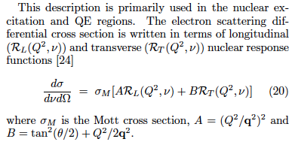
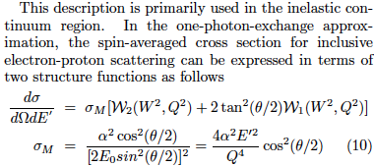



Nuclear Physics
Q² = 4-momentum transfer squared
W² =final state invariant mass squared
q² = 3-momentum transfer squared
E_{x} = Excitation energy
Particle Physics

Slide 4
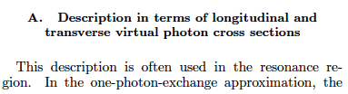

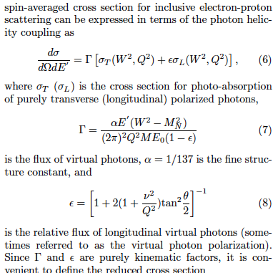

Slide 5
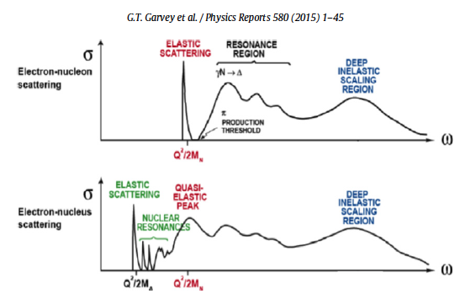
^{P, N}
¹²C
We have initiated a program to extract RL and RT values on various nuclei using all available data. Here we report on our extraction for Carbon. We extract extract RL and RT in all regions, nuclear elastic, nuclear excitations, quasielastic, resonance region and inelastic scattering. We cover the kinematic range 0 < Q² < 3.45 GeV², and energy transfer ν, from ν=0 to the end of the resonance region W=2.0 GeV. We extract at fixed Q² values as a function of ν and also at fixed values of 0.1 < q < 2.78 GeV and 0 < ν < (ν= q, i.e. Q²=0). For Carbon we use 16,000 electron scattering and photproduction cross sections
Goals:
Test first-principle nuclear theories at fixed values of Q² and q.
Comparing to extracted RL and RT values to MC generators covers all kinematic regions is much preferable to validating with cross section data in limited sets of kinematic regions.
Where there is no data, we provide the values from our universal fit to all electron scattering data.
This fit will be made available for validation of electron and neutrino MC generators

Slide 6
First Step: Christy- Bodek Universal Fit (needed for this analysis)
Fit to all of the world’s electron scattering data on H, D and nuclear targets to include the lowest values of energy transfer ν and q² (for carbon we fit about 16,000 e-¹²C and photoprodution cross section We fit the QE cross section (including Transverse Enhancement/MEC, +longitudinal low q suppression) resonance and pion production, DIS, nuclear excitations, elastic scattering data. Note: Nuclear excitations are significant at low ν and contribute up to 30% to the longitudinal Inelastic Coulomb Sum Rule (CSR)
Since the cross sections span a large range of energies and scattering angles, we extract fits to both the longitudinal R_{L} and transverse R_{T} contributions.
We parameterize both the Enhancement of the Transverse QE cross section and the Suppression of the Longitudinal QE cross section. We also extracted the most precise Coulomb Sum rule as a function of q and compare to theoretical calculations.
The fit can be used in lieu of data to benchmark Monte Carlo predictions (e.g. for e-H, e-D and e-¹²C and e-¹O cross sections, and to is being used compute radiative corrections for electron scattering experiments.

Slide 7
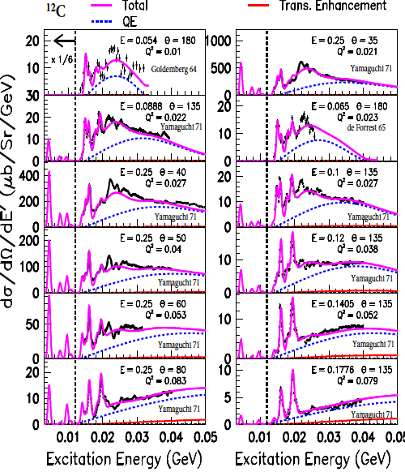
Electron scattering cross sections
Bakcup: 1 Christy- Bodek Universal Fit
Nuclear excitations as example
Cross sections for excitations less than 10 MeV multiplied by (1/6)
Nuclear excitation region
Ex < 50 MeV
Comparison of our fit to representative e-C12 data for 0.01<q²< 0.08 GeV² .
Shown: Total including excitations : solid -------
Quasielastic (QE) contribution: dashed------
Transverse Enhancement at large angles accounts for Meson Exchange Currents and Enhancement of Transverse QE response dashed------

Slide 8
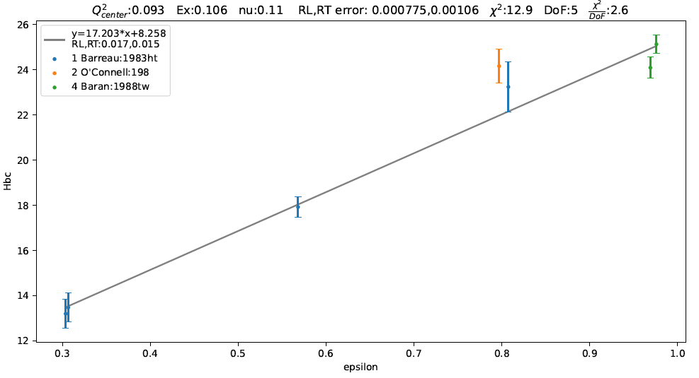

R_{L} R_{T} extractions. (Rosenbluth plots)
We apply Coulomb corrections in the analysis. We bin all cross sections in bins of q (we also do it for bins in Q²), and apply bin centering corrections using the universal fit. Bin centers are at:
18 q values: 0.100, 0.148, 0.167, 0.205, 0.240, 0.300, 0.380, 0.475, 0.570,
0.649, 0.756, 0.991, 1.659, 1.921, 2.213, 2.500, 2.783, 3.500 GeV.
18 Q^{2.} values: 0.00 (photoproduction), 0.010, 0.020, 0.026, 0.040, 0.056, 0.093, 0.120, 0.160, 0.265, 0.38, 0.50, 0.80, 1.25, 1.75, 2.25, 2.75, 3.25, 3.75 GeV².
2. Bin centering correction in q (or Q²). For ν< 50 MeV we bin center the data in bins of Excitation energy E_{x}, and for ν >50 MeV we bin center the data in bins of W² . We then perform Rosenbluth fits versus virtual photon polarization ε extract R_{L} and R_{T} . Laster convert Ex and W² to ν.
ε
ε

Slide 9
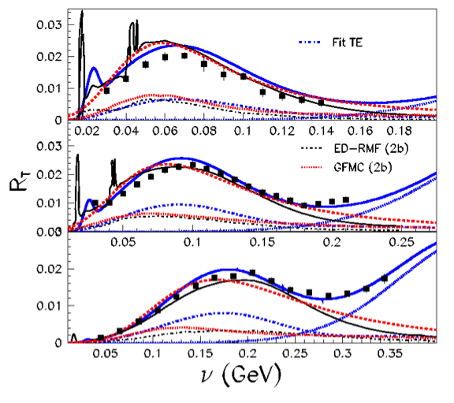
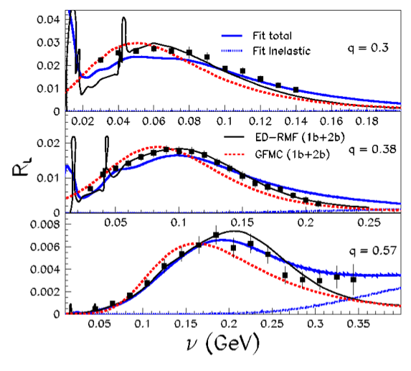
Fixed q : Chirsty- Bodek Fit describes RL and RT
Comparison to nuclear theory for QE 1p1h process
(available only for 3 q values)
USE OUR PLOTS
Shown are theory predictions for QE 1p1h process (including contribution from 1b and 2b currents). There fore, for comparison we also show our universal for QE 1p1ph.
ED-RMF (Energy Depending Relativistic mean field .
And GFMC (Green’s Function Monte Carlo – first principle)
We extract 18 fixed q values - However, at this time predictions are only available for 3 fixed q values.

Slide 10
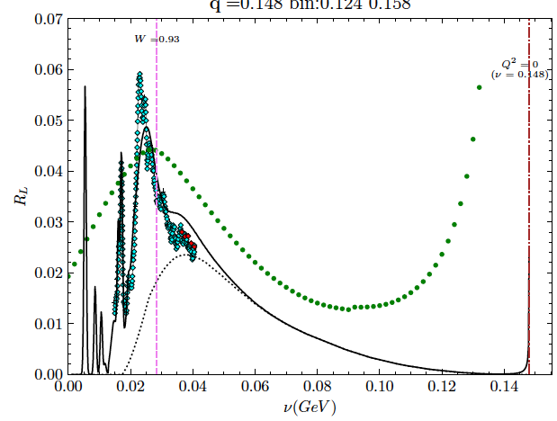
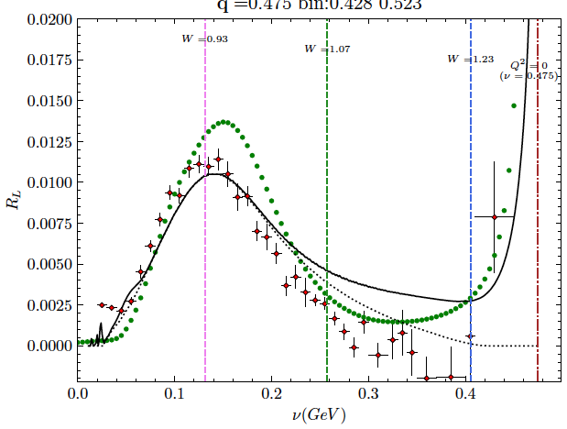
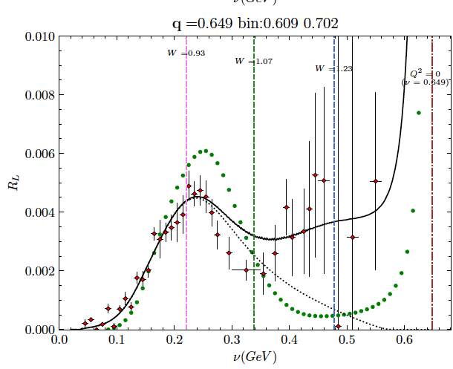
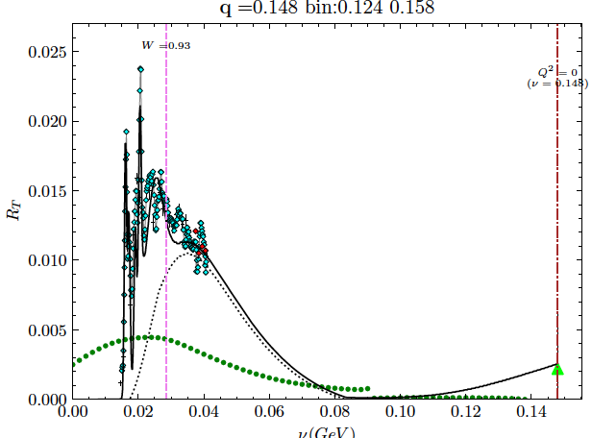
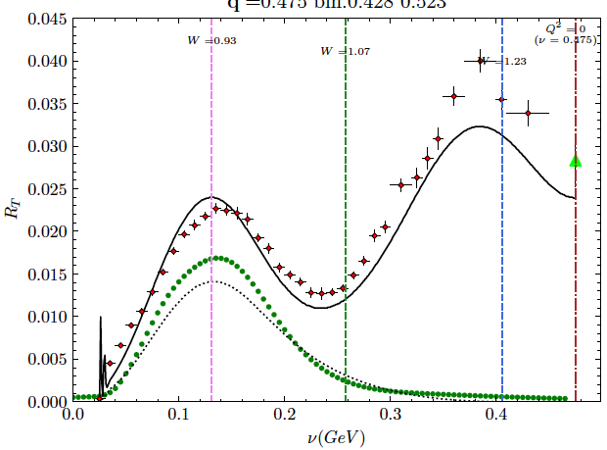
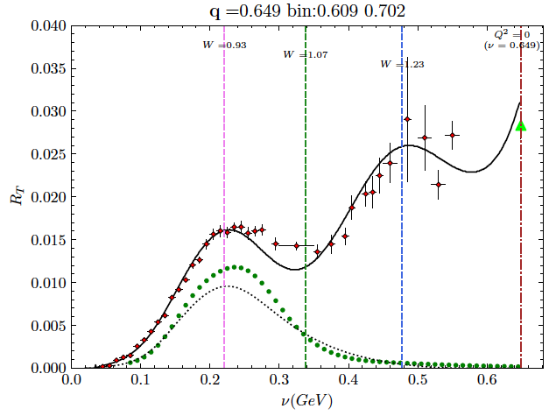
Fixed q : Chirsty- Bodek Fit describes RL and RT
Code, as well as tables of numbers for RL and RT for all q values will be provid
for easy validation of MC generators – Example: Compare to NuWRo which only predicts QE response
. . .
q values: 0.100, 0.148, 0.167, 0.205, 0.240, 0.300, 0.380, 0.475, 0.570, 0.649, 0.756, 0.991, 1.659, 1.921, 2.213, 2.500, 2.783, 3.500 GeV. are shown in Backup Slides. Here we show a 3 examples: Start with fixed q (GeV). The maximum value of ν is ν=q (where it should match photoproduction for RT)
Low q – Large contribution from nuclear excitation. Not included in any MC generators. NuWRo breaks down at low q.
RL: q=0.148 GeV
RL: q=0.475 GeV
RL: q=0.649 GeV
RT: q=0.148 GeV
RT: q=0.475 GeV
RT: q=0.649 GeV

Slide 11
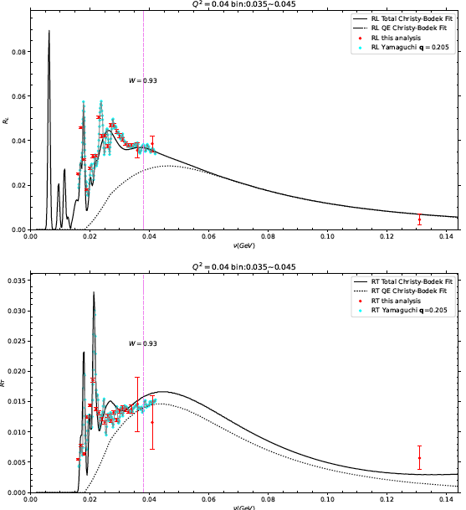
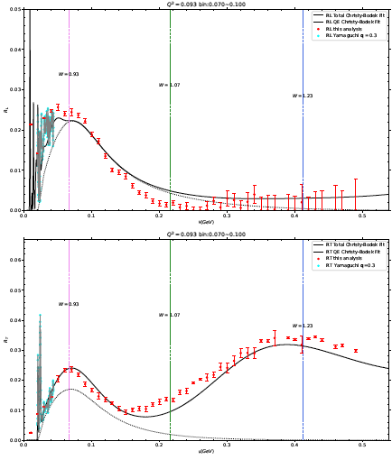
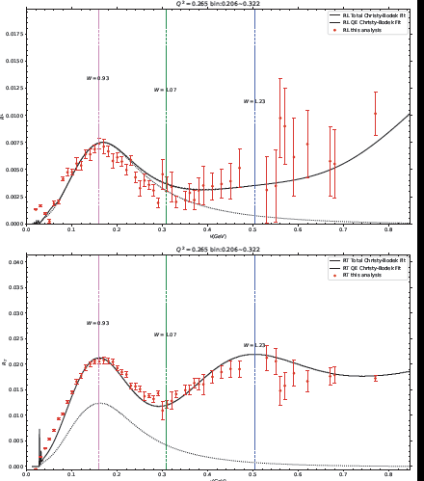
Fixed Q² : Chirsty- Bodek Fit describes RL and RT
Code, as well as tables of numbers for RL and RT for all q values will be provided
for easy validation of MC generators
18 Q^{2.} values: 0.00 (photoproduction), 0.010, 0.020, 0.026, 0.040, 0.056, 0.093, 0.120, 0.160, 0.265, 0.38, 0.50, 0.80, 1.25, 1.75, 2.25, 2.75, 3.25, 3.75 GeV^{2.} are shown in Backup Slides. Here we show a 3 fixed Q² (GeV²) examples. (there is no maximum value of ν )
Low q – Large contribution from nuclear excitation. Not included in any MC generators. NuWRo breaks down at low q.
RL Q²=0.04 GeV²
RL Q²=0.093 GeV²
RL Q²=0.265 GeV²
RT Q²=0.04 GeV²
RT Q²=0.093 GeV²
RT Q²=0.265 GeV²

Slide 12
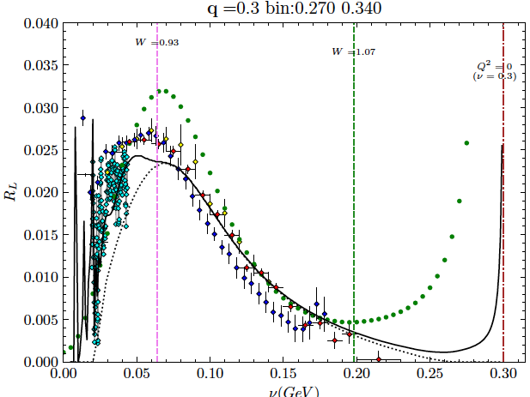
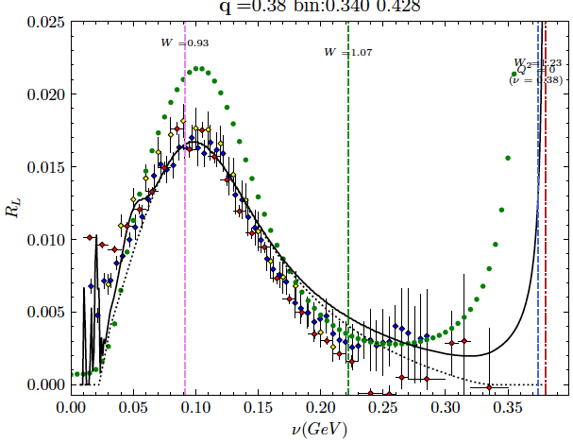
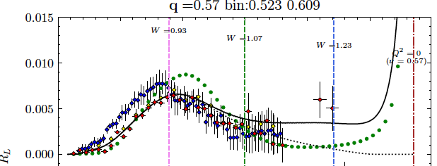

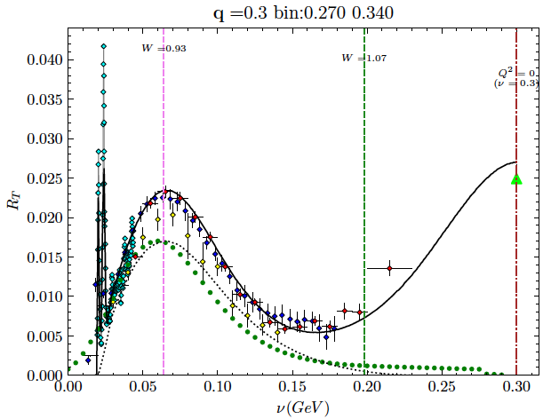
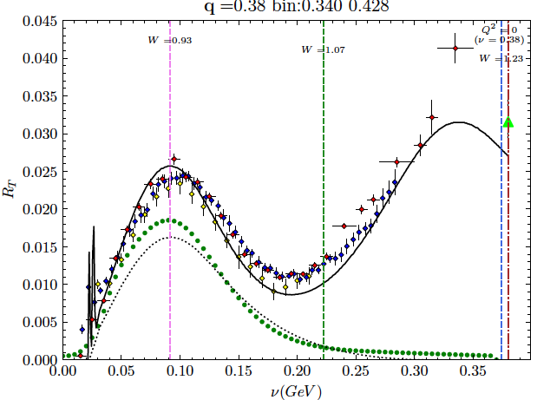
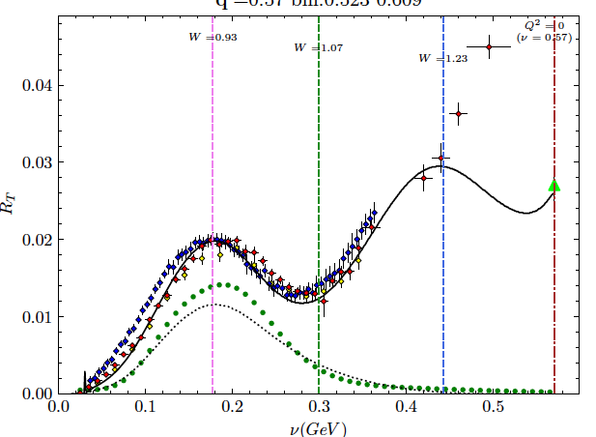
Comparison to previous analyses
(which were only done at 3 values of q)
With all world’s data we have 18 values of q (and Q2) with smaller error bars and larger kinematic range
RL: q=0.30 GeV
RL: q=0.38 GeV
RL: q=0.57 GeV
RT: q=0.30 GeV
RT: q=0.38 GeV
RT: q=0.57 GeV

Slide 13
Conclusions
The 18 R_{L} and R_{T} extractions cover a very large kinematic range. The values are in excellent agreement with the Christy-Bodek Universal fit to all cross section values. Therefore, where there is no data the values form the universal fit can be used.
Good agreement with nuclear theory for 3 values of q. Predictions for all other values of q not yet available.
The R_{L} and R_{T} measurements as well as the universal fit provide a simple way to validate electron and neutrino MC generators over the entire kinematic range of interest.
Tables of the fit values for R_{L} and R_{T} for the 18 q and Q² values will be provided. The contributions of nuclear excitations, QE, transverse enhancement and inelastic scattering will also be listed separately.
Code for the universal fit will be provided.

Slide 14
Backup
Plots of RL and RT at all 18 values of q, and 18 values of Q²

Slide 15
Comparison to options in NuWRo
(1) Relativistic Fermi Gas (RFG). (2) Spectral Function (SF)
(3) Spectral Function plus final state interaction (SF-FSI).
FSI is needs to be included. However, at large Q2 the effect of FSI is smaller

Slide 16
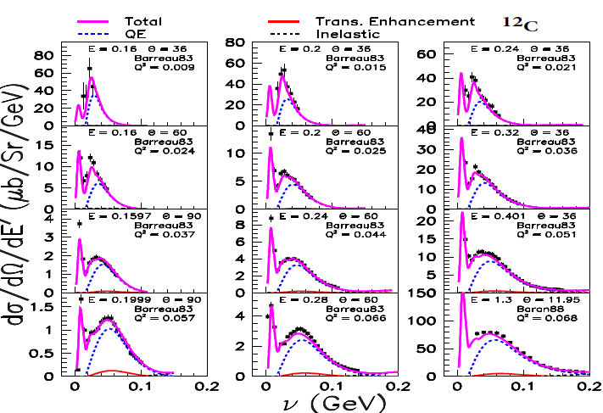
Bakcup: 2 Christy- Bodek Universal Fit
Quasielastic (QE) Region-I
Comparison of our fit to representative e-C12 data
For ν < 0.2 GeV and
0.01 <q²< 0.068 GeV² .
Shown: Total including excitations solid -------
Quasielastic (QE)
contribution dashed ------
Transverse Enhancement at large angles accounts for Meson Exchange Currents and Enhancement of Transverse QE response dashed------

Slide 17
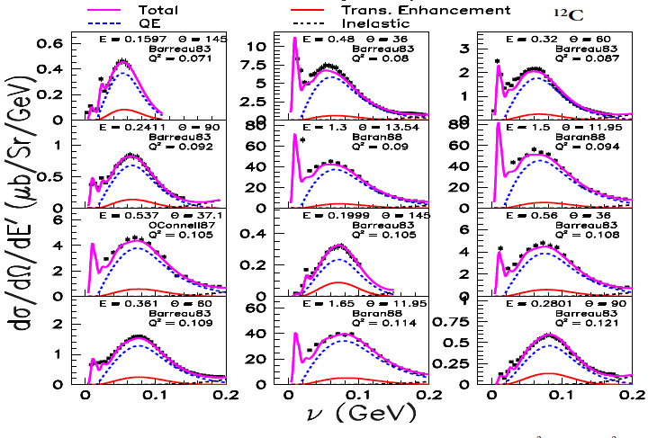
Bakcup: 3 Christy- Bodek Universal Fit
Quasielastic (QE) Region II
Comparison of our fit to representative e-C12 data for < 0.2 GeV and
0.071 <q²< 0.121 GeV² .
Shown: Total including excitations solid -------
Quasielastic (QE)
contribution dashed ------
Transverse Enhancement at large angles accounts for Meson Exchange Currents and Enhancement of Transverse QE reponse dashed------

Slide 18
Backup 4: Christy- Bodek Universal Fit - Fit functional forms for RL RT
¹²C
90⁰
60⁰
13.5⁰
60⁰
13.5⁰
145⁰
145⁰
15.5⁰
60⁰
The overall fit provides R_{L} and R_{T} at all values of q
Shown are large and small angle cross sections at the same q that provide the major contribution to the extraction of R_{L} and R_{T} at
q²=0.09, 0.15 and 0.35 GeV² (q=0.3, 0.38 and 0.57 GeV)

Slide 19
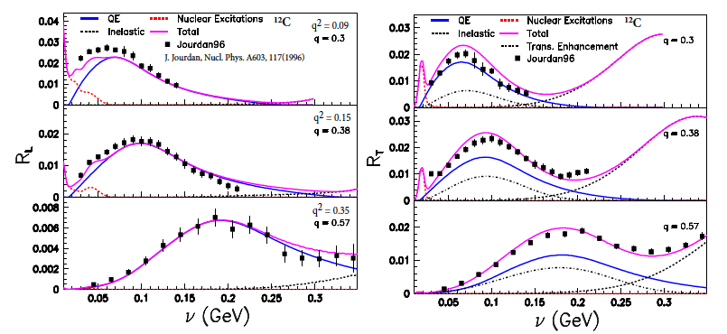
Bakcup: 5 Christy- Bodek Universal Fit
Comparison of our R_{L} and R_{T} from our universal fit to (~8000 cross sections) to previous extraction by Jourdan at q²=0.09, 0.15 and 0.35 GeV². (q=0.3, 0.38 and 0.57 GeV)
Our extraction is more reliable since we include all of the world’s data in the fit
At low q the contribution of the nuclear excitations important.
The superscaling fit function describes the QE distribution at higher ν.
Resonance region is modeled with Fermi Smeared H and D data.

